Slide 1



Phishing Awareness Training
Welcome to this training module on phishing awareness. You will learn how to recognize and avoid phishing attacks. This knowledge will help protect you from cyber threats.

Slide 2

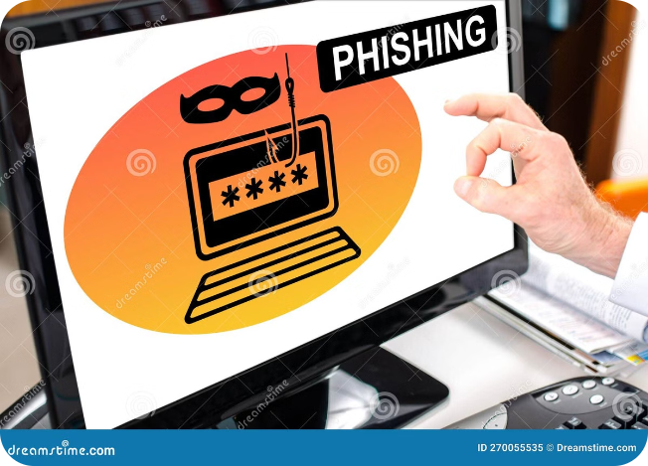
Understanding Phishing Attacks
1
Deceptive Emails
2
Stolen Data
Phishing involves sending emails that appear legitimate but are actually designed to steal your personal information. They often impersonate trusted organizations or individuals.
Phishing attacks aim to obtain sensitive data such as your login credentials, credit card numbers, or social security numbers. These attacks can have severe consequences for both individuals and organizations.
3
Financial Loss
Phishing can lead to financial losses, identity theft, and reputational damage. By understanding phishing tactics, you can protect yourself from these risks.

Slide 3
Recognizing Phishing Emails
Suspicious Sender
Urgency or Fear
Unclear Links
Check the sender's email address carefully. If it looks unusual or misspelled, it's likely a phishing attempt.
Phishing emails often create a sense of urgency or fear, pressuring you to act quickly. Don't let this influence your judgment.
Hover over links before clicking them. If the URL doesn't match the expected website or looks suspicious, it's best to avoid clicking.

Slide 4

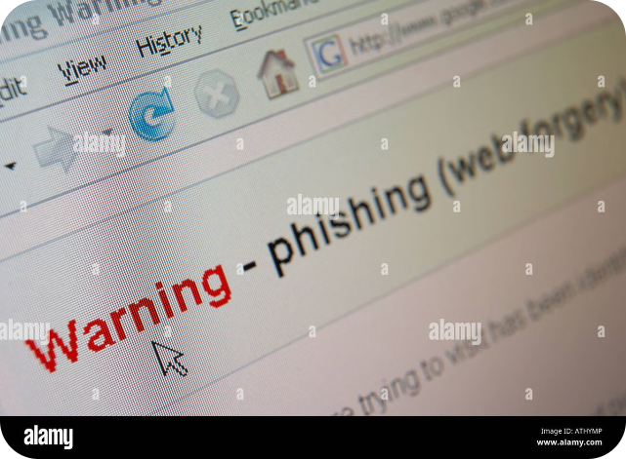
Identifying Phishing Websites
Incorrect Spelling
Unfamiliar URL
Phishing websites often have spelling errors in their domain names or on their pages. This is a common giveaway.
The website address should match the expected domain name. Be wary of websites with unusual or unfamiliar URLs.
Security Concerns
Look for a secure connection symbol (a padlock icon) in your browser's address bar. It indicates that the website is encrypted.

Slide 5


Avoiding Social Engineering Tactics
1
Building Trust
Social engineering relies on building trust and exploiting human emotions. Be wary of individuals who try to gain your trust quickly.
2
Information Gathering
Phishing attacks often involve gathering information about you to make the attack appear more legitimate. Be cautious about sharing personal data.
3
Exploiting Fears
Phishing attacks may use fear tactics or threats to pressure you into taking immediate action. Take your time and make informed decisions.

Slide 6

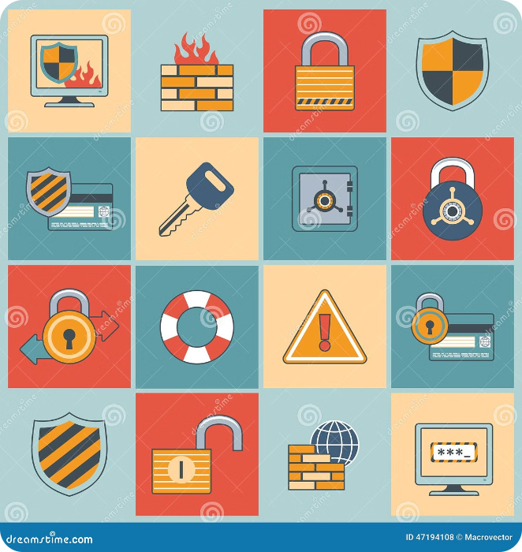



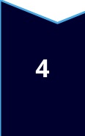
Best Practices for Phishing Prevention
Strong Passwords
Use strong and unique passwords for each account. Avoid using the same password for multiple accounts.
Two-Factor Authentication
Enable two-factor authentication whenever possible. This adds an extra layer of security to your accounts.
Regular Updates
Keep your software and operating system up to date. Regular updates patch vulnerabilities that can be exploited by phishing attacks.
Be Aware
Be mindful of the information you share online. Think twice before clicking on links or opening attachments from unknown senders.

Slide 7

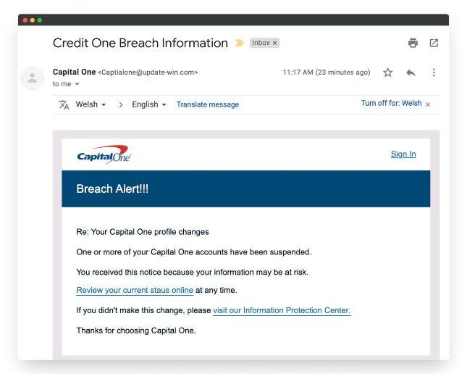
Real-World Phishing Examples
Fake Bank Emails
Emails impersonating banks to trick you into revealing your login credentials or account information.
Social Media Scams
Phishing attacks disguised as social media posts or messages, often offering deals or promotions.
Fake Job Offers
Phishing emails that promise attractive job opportunities to steal your personal information or access your computer.

Slide 8

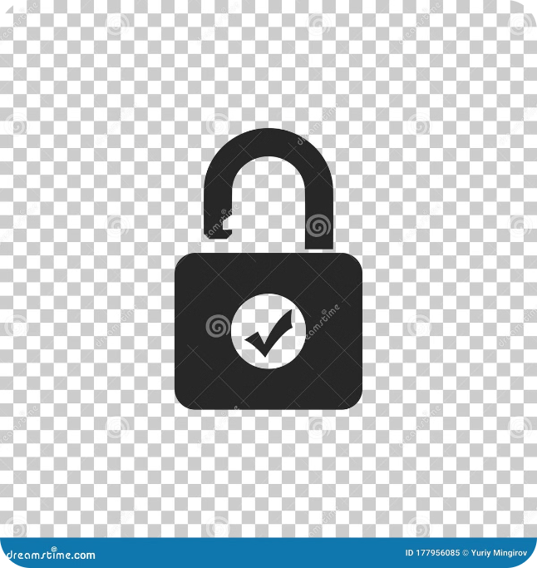




Conclusion and Key Takeaways
Stay Vigilant
Don't Click
Be constantly aware of phishing attempts and practice safe online behavior.
Think before you click on links or open attachments from unknown senders.
Verify Information
Report Suspicious Activity
Double-check the sender's email address and the website URL before taking any action.
Report any suspected phishing attempts to your IT department or the appropriate authorities.

